Slide 1
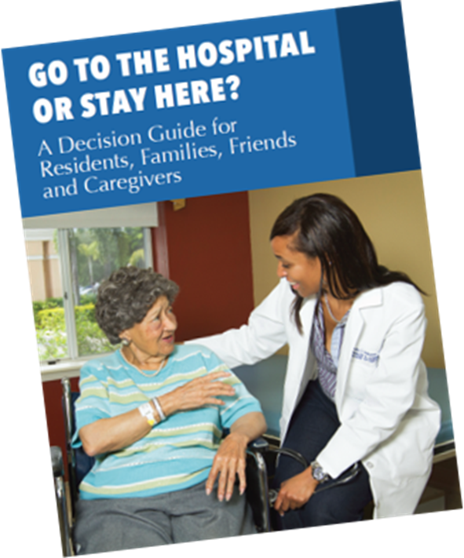
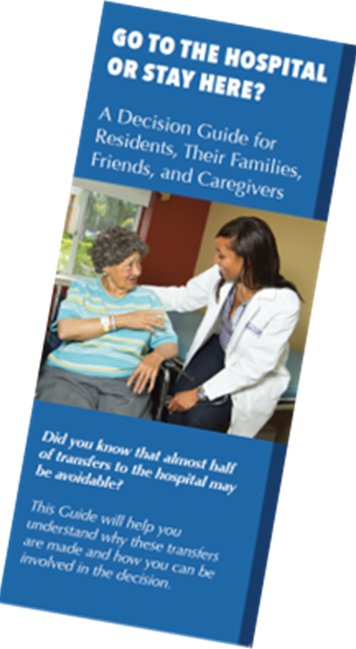
How to Implement The Decision Guide
Notes:
ll SNFs paid under the SNF Prospective Payment System (PPS) are included in the SNF VBP Program and are eligible for payment incentives based on their performance on the program’s measure. The types of SNFs in the Program include freestanding SNFs, SNFs associated with acute care facilities, and all non-critical access hospital (CAH) swing bed rural facilities.
What measures will be used in the SNF VBP Program?
Skilled Nursing Facility 30-Day All-Cause Readmission Measure
The Skilled Nursing Facility 30-Day All-Cause Readmission Measure (SNFRM) is used in the SNF VBP Program. The SNFRM estimates the risk-standardized rate of unplanned readmissions within 30 days for:
People with fee-for-service Medicare who were inpatients at PPS, critical access, or psychiatric hospitals.
Any cause or condition.

Slide 2
This presentation provides ways that you can use the Decision Guide, as well as comments and data from Region IV Nursing Homes who used Guide.

Slide 3
Benefits of the Guide
It provides factual information about the care that can be provided in your facility
It addresses questions about that care in the right setting and the available choices when a resident’s condition changes
Our study demonstrated that facilities who include the Guide in their readmission strategy significantly reduced avoidable transfers

Slide 4
Nursing Homes Using the Guide: Strategy and Success
Reducing Avoidable Transfer Strategy
Staff Education
Training Videos, Case Studies, Presentations.
Provide the Guide
to all residents, families and incorporated in admission and care plan meetings
Medical Director/
Advanced Practice staff have an active role in having care discussions using the Guide

Slide 5
Use of the Guide can also Support QAPI
QAPI - Improving avoidable Readmissions
The Guide as a Tool
Provides factual information on whether to go or not go to the hospital
Supports ongoing education for all staff on ways to prevent “panic transfers to the ED”
Identifies areas for organizational improvement

Slide 6
The Guide Complements Interact
FACILITIES THAT USE BOTH REPORT INCREASED REDUCTION IN FAMILY INSISTED TRANSFERS!
INTERACT
Decision Guide
Quality improvement program
Tools and resources to help identify, evaluate, and manage changes in condition
plus
To inform residents and families of treatments provided in nursing home.
Elicit questions on sensitive issues like end of life care

Slide 8
Getting the Guide
Download and print your guide
www.decisionguide.org
or
Purchase the Guide from Med Pass
at
https://www.med-pass.com/index.php/go-to-the-hospital-or-stay-here-guide-25-pack.html
for the booklet,
and
https://www.med-pass.com/index.php/go-to-the-hospital-or-stay-here-brochure-25-pack.html
for the trifold

Slide 9
Best Practices Implementation Guide
(Planning tool for roll out)
The Guide
(Provides the factual information on making the decision)
Videos and Case Studies
(Supports ongoing education)
Access Program Materials at www.decisionguide.org
Notes:
toolkit

Slide 10
Getting Started
Use the Best Practices Guide for Implementation for planning rollout
http://www.decisionguide.org/docs/ImplementationAssistant
Training Videos and Case Studies are useful for staff education
Share the Guide with your Medical Staff, Leadership and Nursing staff
Many facilities use the Guide itself for staff education

Slide 11
Educational Material Videos for Staff

Slide 12
Project Website
Incorporating Avoidable Admission/Readmission into Staff Education

Slide 13
What We Have Learned- Impact on Staff
Educational tool for staff nurses
Great for retraining staff
Helps staff initiate difficult conversations e.g. end of life care decision
Strengthens staff confidence in decisions and the follow-up measures necessary when a change in a resident’s condition occurs.
Notes:
Training Materials helped us educate the staff

Slide 14
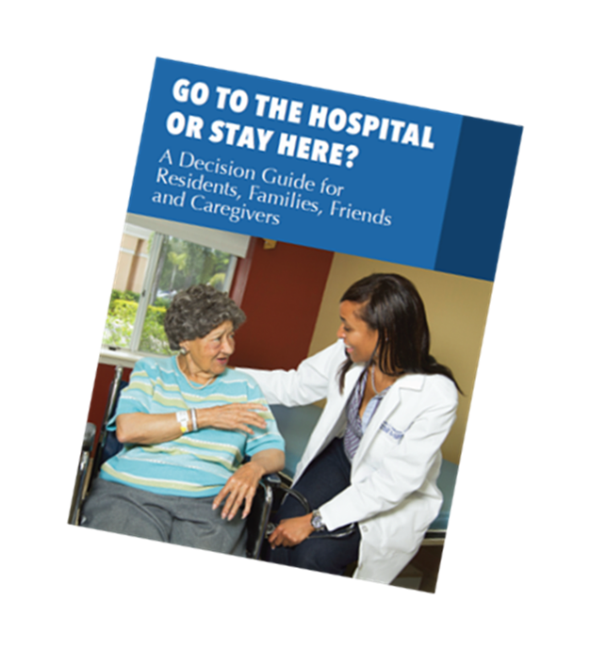
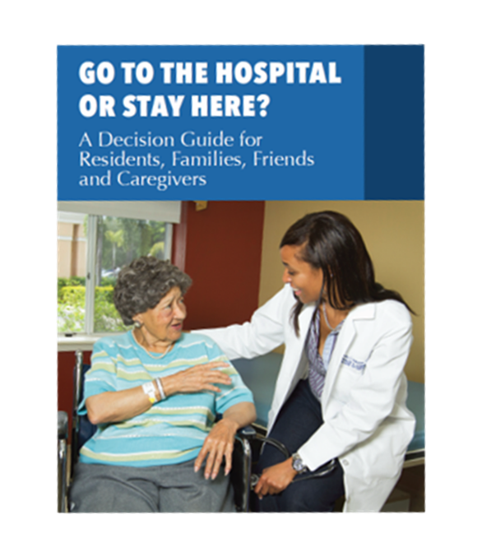
Highlight how your facility is working to prevent avoidable transfers and readmissions to the hospital
Review the Guide and plan when it will be introduced to the Resident and Family
Review some recent transfers that could have been prevented-use a training video to emphasize learning
Use a case study to engage staff in the discussion
Educating Staff In 30 Minutes
Notes:
Best practice from the pilot

Slide 15
What We Have Learned Staff Experience
The guide is a useful tool for clinicians (Physicians, Nurse Practitioners, and Nurses) to use during resident/family-clinician conversations related to going to the hospital or staying in the nursing home. Covers important facts on hospital transfers, transitional care, hospice care, and advance directives.
“One more tool in our toolbox”
NHA-Georgia

Slide 16
Helping Families Use the Guide
Educational tool for residents and families to inform them on the treatment options that can be performed in the nursing home.
“In a crisis, family members panic, staff panic. Just stop and think what we can do here. The guide is a great educational tool.”
NHA, Alabama

Slide 17
Page 3 of the Guide
“It depends on what is going on, the severity of the illness. Give me a run down on what the hospital can do for me and what they can do for me here.” (Patient)
“I don’t want to push the panic button and send her to a hospital if it can be kept under control here.” (Son)
2
REASONS TO PREFER BEING TREATED HERE
Many tests and treatments can be provided in the nursing home:
•Medications
•X-rays
•Blood tests
•Oxygen
•Wound care
•Checking on you and reporting to your doctor or other medical provider
•Comfort care (pain relief, fluids, bed rest)
•IV (intravenous) fluids in some facilities
•Physical or Occupational Therapy
•Speech Therapy
You can ask your nurse, doctor or other medical provider what else can be done for you here.
Sample page
REASONS TO PREFER BEING TREATED IN THE HOSPITAL
Hospitals can provide more complex tests and including:
•Heart monitoring
•Body scans
•Intensive care
•Blood transfusion
•Surgery
treatments
THERE ARE ALSO RISKS TO GOING TO THE HOSPITAL
Being transported to the hospital can be stressful. You are likely to have to explain your concerns to nurses and doctors you do not know. You are also at greater risk for skin breakdown, exposure to infections or falling in an unfamiliar place. You may feel more comfortable staying here and being cared for by staff who know you. You should carefully consider all factors when making your decision.

Slide 18
Increased Family Knowledge
Staff Education
Increased Resident Knowledge
Reference for End of Life Care

Slide 19
Distributing the Guide
Have the guide available in the resident’s room.
“We have the Guide in a binder at each resident’s bedside. We find quite frequently that the copies of the Guide are removed-so people are reading the Guide.”
Executive, Nursing Home, Alabama

Slide 20
“It gives family members a better understanding of what questions to ask regarding nursing home services provided at this facility. It helps them (families) in structured meetings to ask questions about services.” [NHA, Tennessee]

Slide 21
What We Have Learned: Helps with the End of Life Plan of Care Discussion
Helps to set resident/family goals for care and support discussion of their expectations such as the quality of care for the resident versus quantity of care.
“The Guide is very colorful and laid out in easy to read facts with resident and family quotes from interviews. It opens that dialogue for residents and families to have discussions around end of life care. DON, Alabama

Slide 22
Successful Implementation Strategies
Include in admission packet
Use in conversation with families/residents
Staff education on readmissions
Use during care planning meetings
Introduce during resident council meetings
Sharing with hospital staff
For additional strategies, see Best Practices for Guide Implementation on our website http://decisionguide.org/

Slide 23
Working With Your Hospital
Distribute the guide to case managers at local hospitals.
Provide workshops to reinforce information-also support networking between nursing home personnel and hospital personnel
Create your own slogan for using the decision guide for your facility.

Slide 24
Thank You
Florida Atlantic University
Christine E. Lynn College of Nursing
Boca Raton, Florida
For more information contact:
Florida Atlantic University
Ruth M. Tappen, EdD, RN, FAAN
777 Glades Rd, Boca Raton, FL 33431
Phone: 561-297-2613
Email: rtappen@health.fau.edu Project Email: nurtappen@health.fau.edu

